Slide 1
Computer Networks: Course Overview
Prof. Swarnalata Bollavarapu
Contact: swarnalata.b@nmims.edu

Slide 2
Code of Conduct
This online platform tool is not meant for chatting with your friends.
If you are asked to use the chat window, strictly use it for the intended purpose.
All the students have to keep their audio mute, unless asked to unmute.
If there is any issue during the online session for example, slides not changing, I am not audible, CR/SR should immediately inform me
Any queries should be routed through CR/SR, except your personal queries, if any, pertaining to course matter.
Lab sessions/Assignments will be strictly time bound assignments
Attendance will be taken any time during the session

Slide 3
Contents
Why we need to study computer networks
Why there are standards for networking
Why we use networks
Course Objective and Outcomes
ICA Distribution
Textbooks to refer

Slide 4
Why we need to study computer networks
Which of the following Internet services, do you use on daily basis/frequent basis
1. Communication(Email)
2. Entertainment (Online gaming, YouTube videos)
3. Social Networking sites (Facebook)
4. Education (Online MOOC courses )
5. Online business (shopping)
6. All of the above

Slide 5
Reasons why we need to study computer networks
Wide-spread connectivity
Internet services
Wireless networks
IoT
NFC (near field communication)

Slide 6
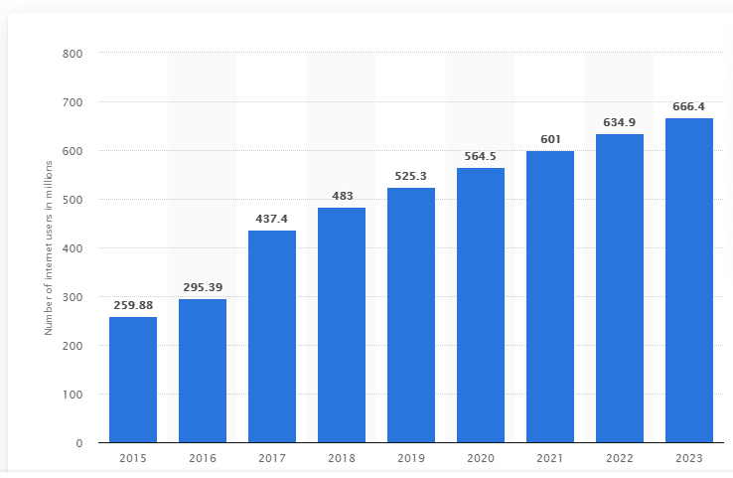
Number of internet users in India from 2015 to 2018 with a forecast until 2023(in millions)
Source: https://www.statista.com/statistics/255146/number-of-internet-users-in-india/

Slide 7
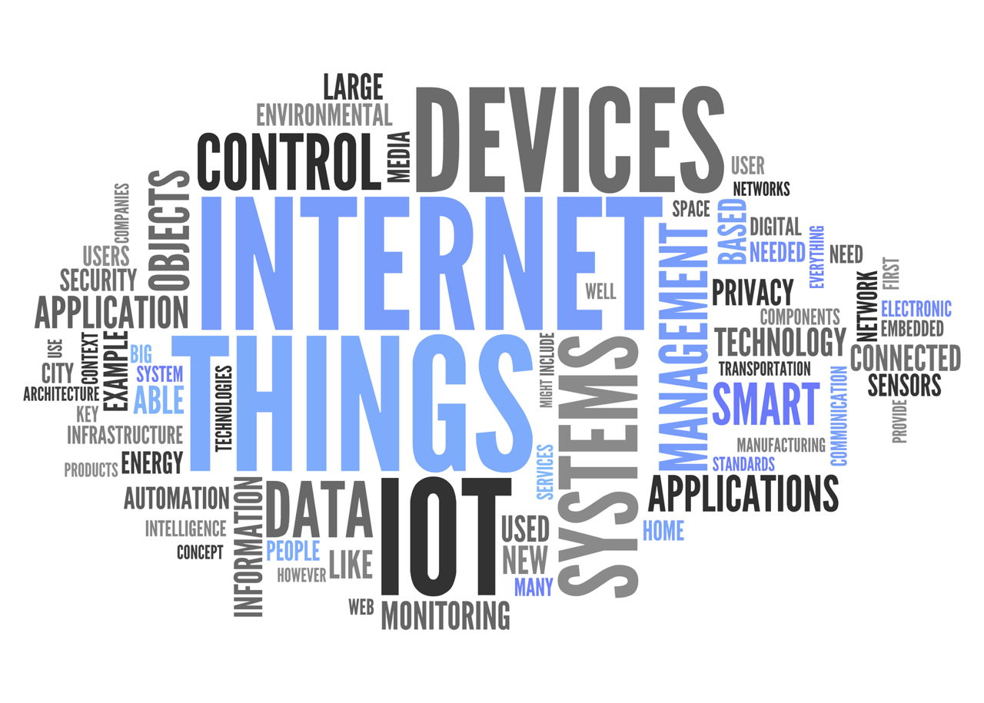
Use of Internet in our Daily lives
Source: https://techspirited.com/internet-its-uses-in-our-daily-life

Slide 8
Use of Internet in our Daily lives
1 second stats
Approx. 3 M emails are sent (67% is spam)
Approx. 1 lakh videos are watched on YouTube
Approx. 1 lakh google searches
Approx. 96,000 GB of Internet traffic
Source: https://www.internetlivestats.com/one-second/

Slide 9
Use of Internet in our Daily lives
High dependency on Internet/ Networks
Fundamental knowledge

Slide 10
Why there are standards for networking
In general, standardization has following outcomes:
Confidence: demonstrates quality
Performance: improves efficiency, fine tune performance
Growth: facilitate economic growth
Sustainability: make technology safer, interoperable
Innovation: provides essential platform
Competition

Slide 11
Why there are standards for networking
ensure the interoperability of networking technologies by defining the rules of communication among networked devices.
help ensure products of different vendors are able to work together in a network without risk of incompatibility.
Example: Ethernet IEEE 802.3

Slide 12
Why we use Networks?
Human Networks | Computer Networks
Benefits:
To share information | Same
To share the resources | Same
Improve productivity, expand business, to scale up | Same
Challenges:
Common language | ??
Boundless- Expand your n/w to any level | ??

Slide 13
Course Objective and Outcomes
To provide the fundamental knowledge of computer networks through the understanding of ISO-OSI Model

Slide 14
Course Outcomes
Discuss the fundamental of computer networks, its types, transmission modes and different reference models
Implement error free transmission of data and analyze data collision with various protocols
Implement various routing and congestion control algorithms over a network
Identify Quality of service parameters and addressing techniques

Slide 15
ISO OSI Model: background
International Organization for Standardization (ISO) [1977]: conducted a program to develop general standards and methods of networking
They came up with [1983] Basic Reference Model for Open Systems Interconnection, usually referred to as the Open Systems Interconnection Reference Model ,simply OSI model
OSI had two major components, an abstract model of networking seven-layer model, and a set of specific protocols.
It promoted the idea of a consistent model of protocol layers, defining interoperability between network devices and software.

Slide 16
Textbooks to refer
1. Andrew S. Tanenbaum,“Computer Networks“, Pearson Education, Fourth Edition, 2009.
2. TCP/IP Protocol Suite, Fourth Edition, Behrouz A. Forouzan, Mc Graw Hill Education.

Slide 17
ICA distribution
Assessment Tool | Marks
Mid-term test 1 | 10
Mid-term test 2 | 10
Lab Performance | 10
Assignment | 10
Presentation | 10
Total | 50

Slide 18
H/W task
History of Computer Networks
Short Quiz based on this in the next lecture

